Slide 1
Universal Gates
Digital Logic Design

Slide 2


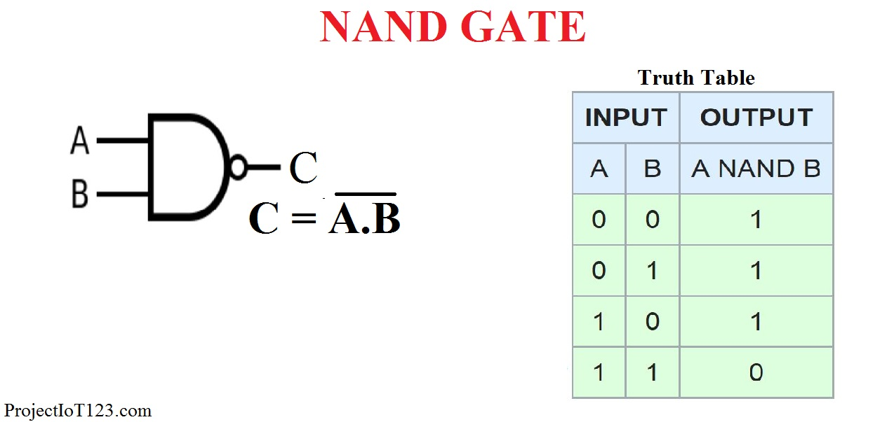
The NAND Gate as a Universal Logic Element

Slide 3

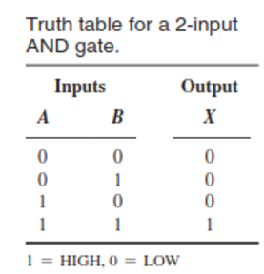
AND Gate

Slide 4
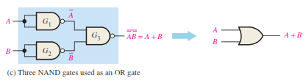
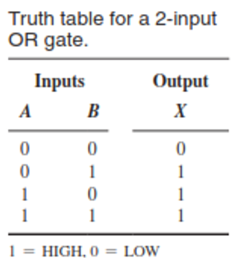
OR Gate

Slide 5

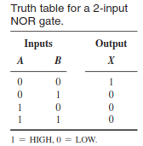
Nor Gate

Slide 6
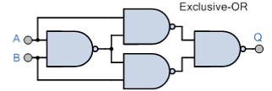
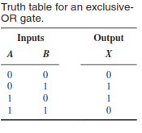
Ex-OR

Slide 7
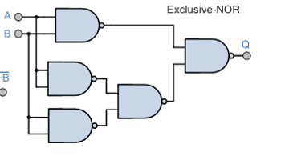
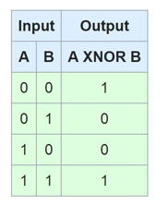
XNOR Gate

Slide 8


NOR Realization
Not Gate
OR Gate

Slide 9
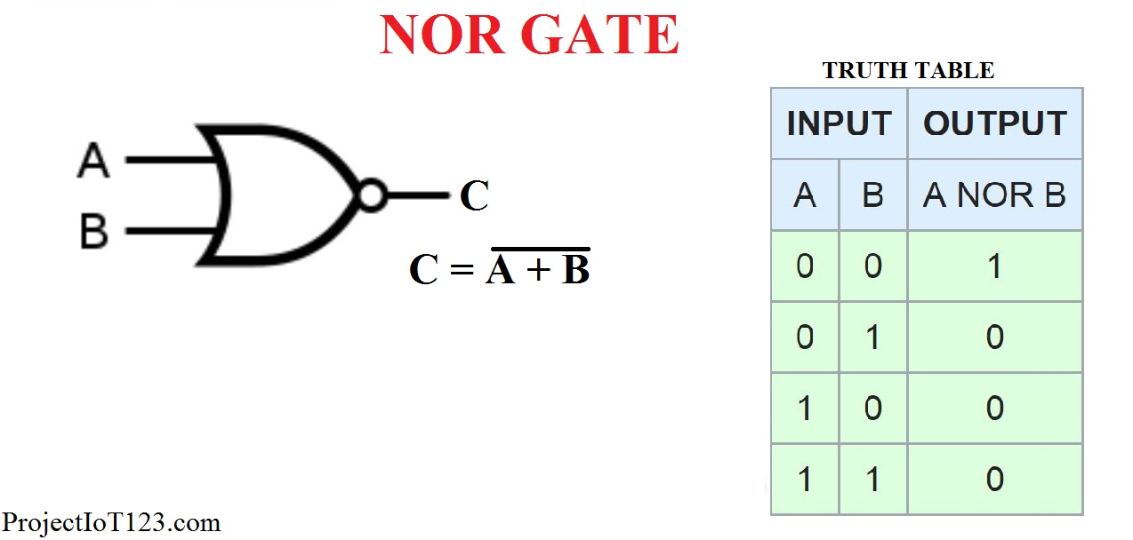

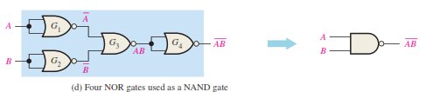
NOR Realization
And Gate
NAND Gate

Slide 10
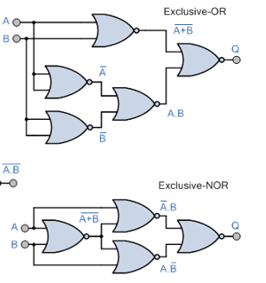
NOR Realization

Slide 11

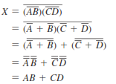

Combinational Logic Using NAND and NOR Gates

Slide 12
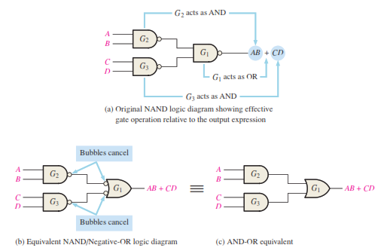

Slide 13
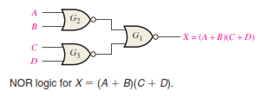

Slide 14
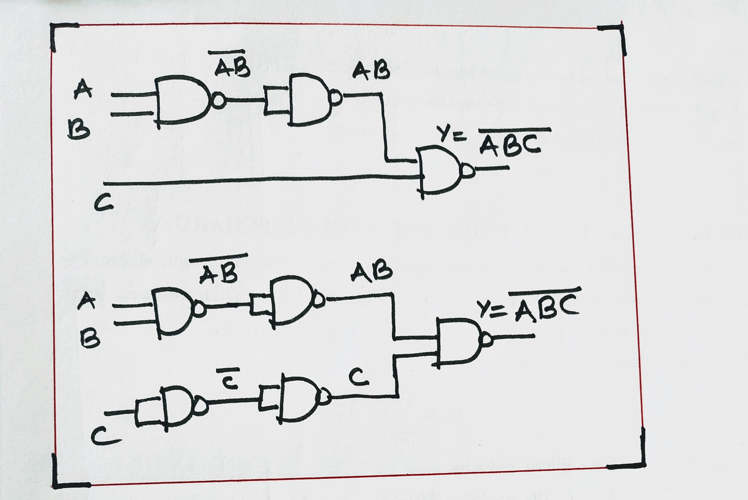
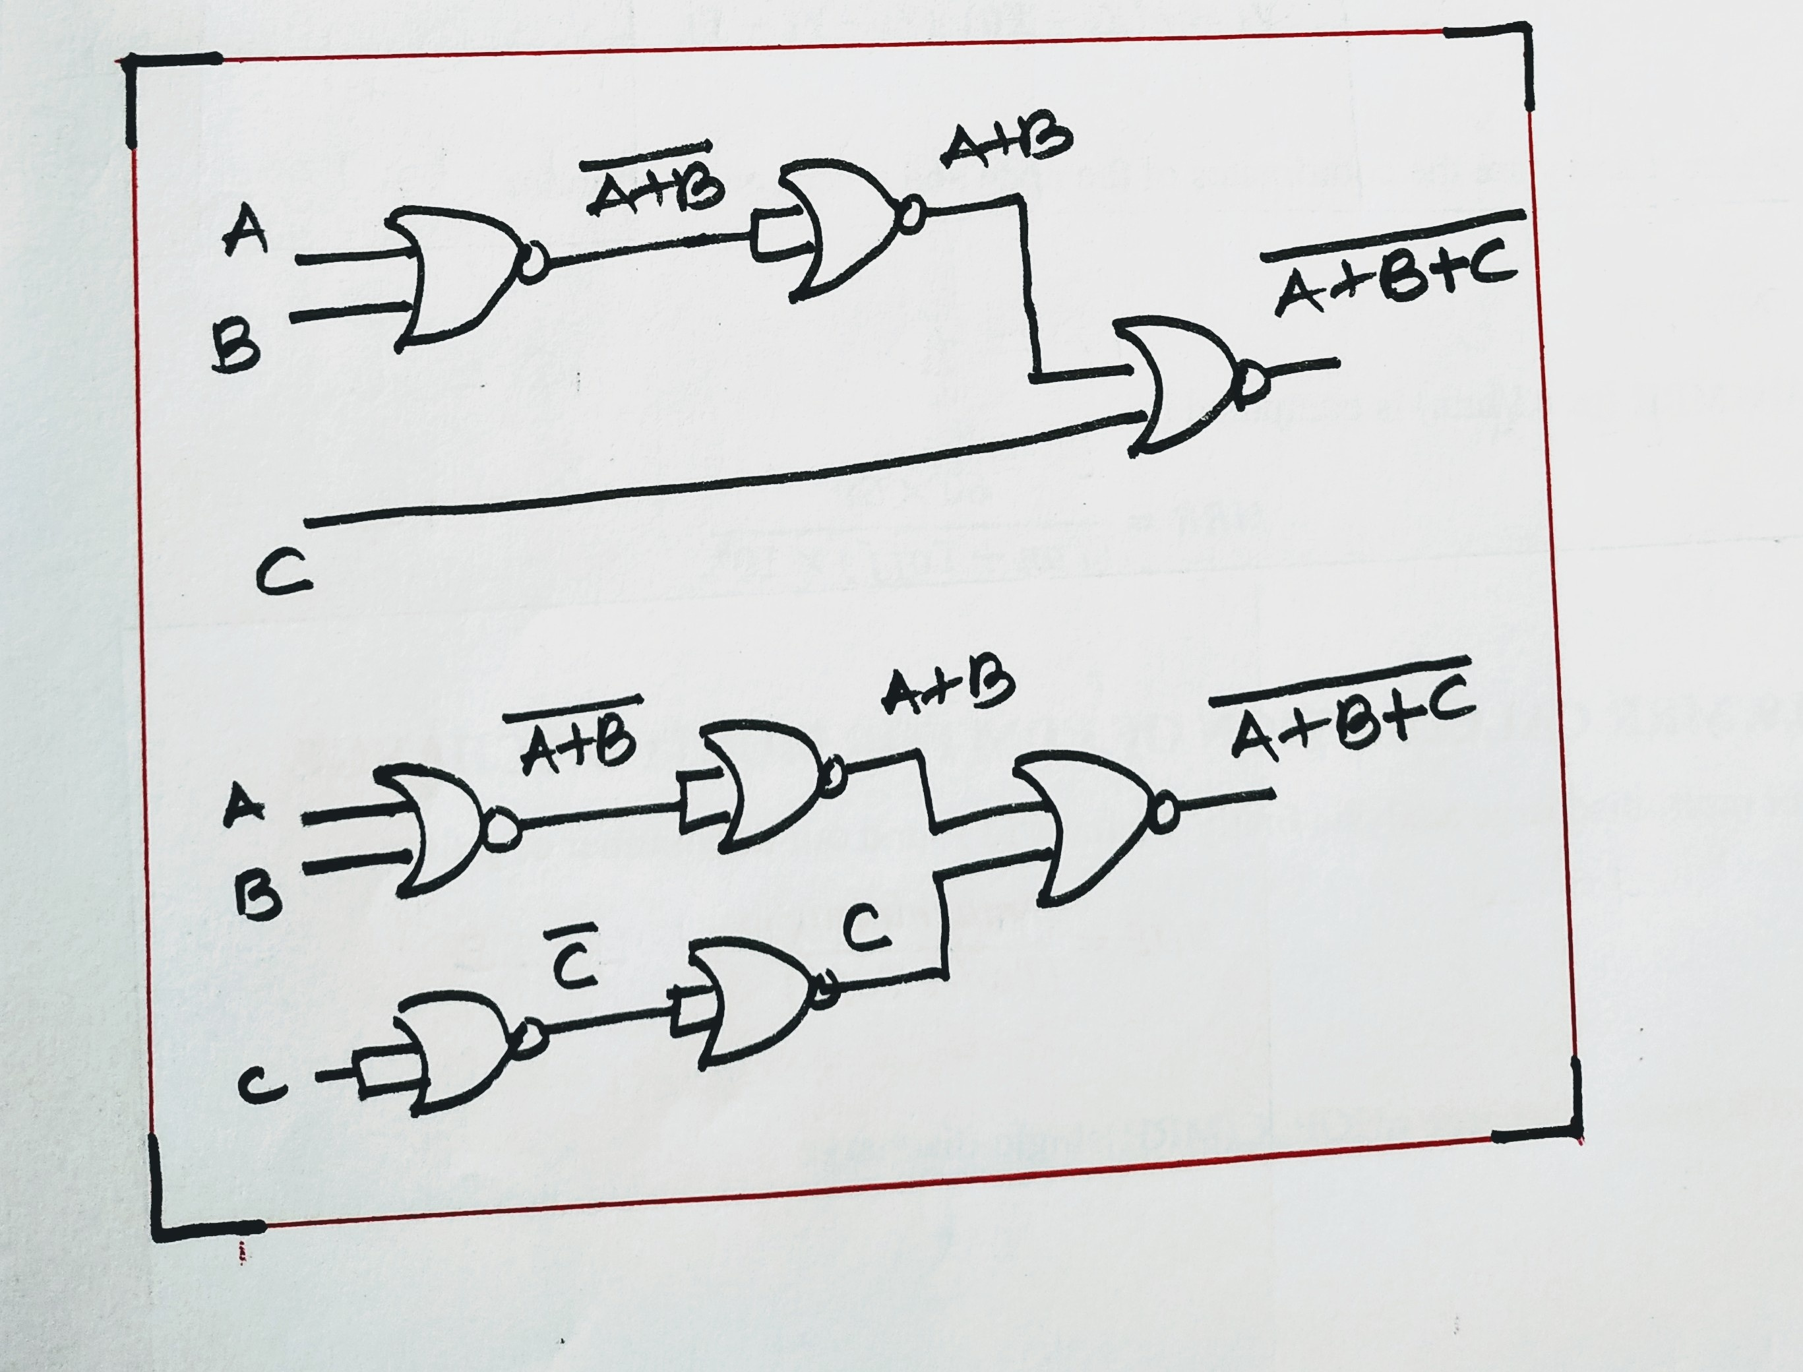
3 input NAND and NOR gate

Slide 15
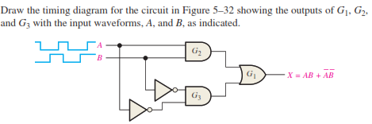
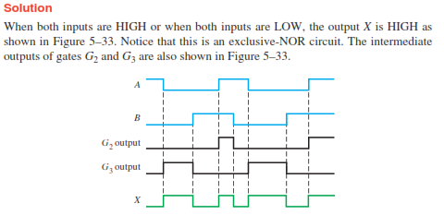

Slide 16
Tasks
AB+CD Use NAND gate
(A+B)(C+D) Use NOR Gates
(A+B’).C.(B+C+D) Nor implementation
A.B’+A’.B Nand Gate
A’.B’.C+A’.C+A.C.D+A.C.D’+A’.B’.D’ simplify and implement with two level NAND gate circuit.

Slide 17
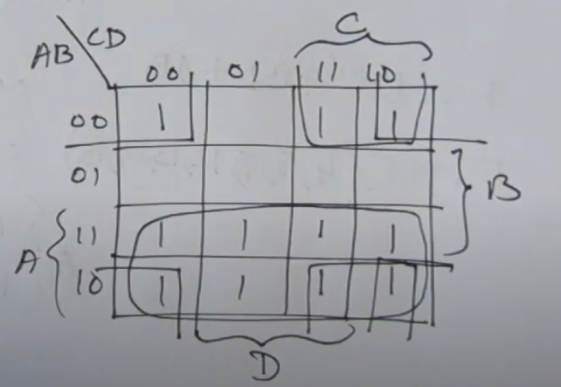
A’.B’.C+A’.C+A.C.D+A.C.D’+A’.B’.D’ simplify and implement with two level NAND gate circuit.

